Slide 1


A new structure for version control in a deep time knowledge graph
Xiaogang (Marshall) Ma
Department of Computer Science
Department of Geological Sciences
University of Idaho
deeptimekb.org | @dtkb11 | max@uidaho.edu

Slide 2
Outline
Deep time knowledge graph
TBox + Abox
Existing work and our objective
The version control structure
Versioning of concepts, attributes and relationships
An efficient usage of the vocabulary scheme ID
Consistency with existing work
Resulting knowledge graph
Experiments of querying version information
Summary

Slide 3
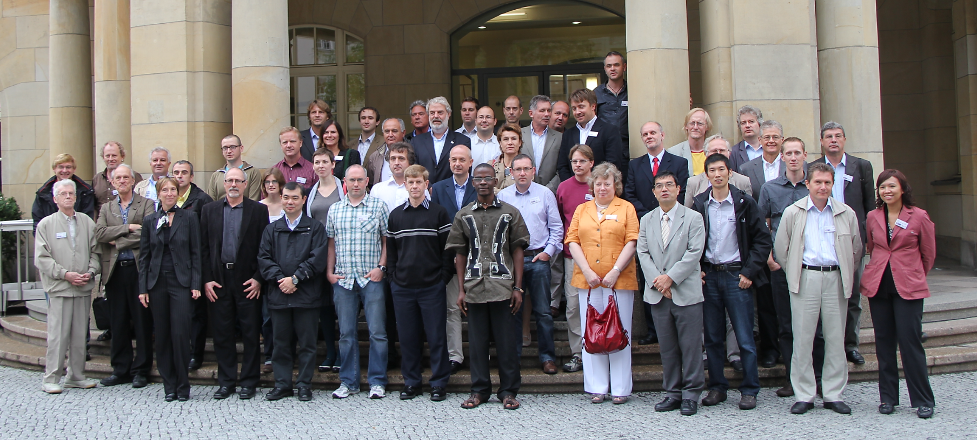
The Origin: 10 years ago
First International Workshop on Geoscience Language, Berlin, 2010
CGI-IUGS, ICS-IUGS, INSPIRE, OneGeology, CGMW, EuroGeoSurveys, CCOP, …

Slide 4
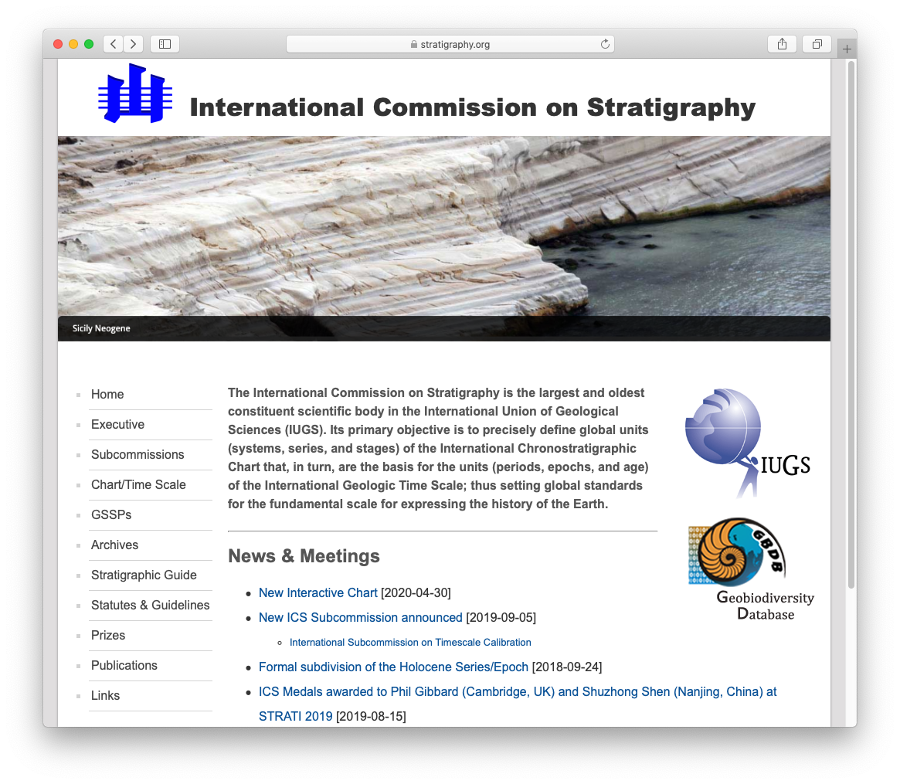
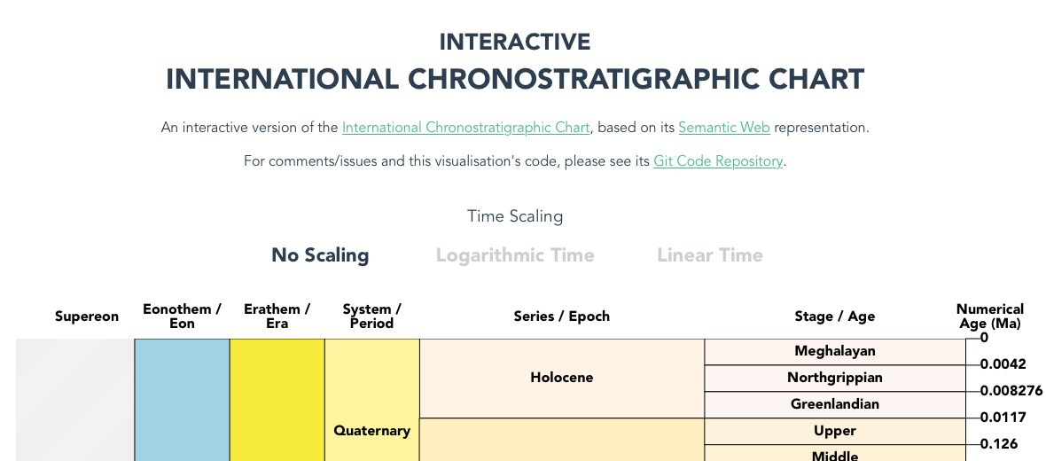

Slide 5
Deep time knowledge graph
TBox + Abox
TBox: a list of classes and properties
ABox: a list of instances of those classes
Existing work
Two key classes in deep time: instant (i.e., a point in time) and interval (i.e., a period of time) (Cox and Richard, 2005)
Cox and Richard have created ontologies, vocabularies and services for geologic time scales
http://resource.geosciml.org
Very recently, W3C-OGC Time Ontology has been incorporated into the deep time knowledge graph (Cox, 2016)

Slide 6
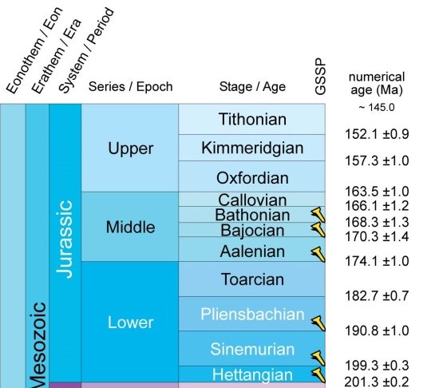
Two key concepts
Interval (Unit ): a period of time between two events
Instant (Boundary): a particular point in time
We can see Jurassic as an Interval and its start and end time (base and top boundary) each as an Instant

Slide 7
An ordinal hierarchical structure
ordinal
hierarchical
7

Slide 8
Core ontologies in the existing deep time knowledge graph (Cox and Richard, 2015; Cox, 2016)
Prefix | Namespace | Role in the deep time knowledge graph
dc | <http://purl.org/dc/elements/1.1/> | Specify metadata of vocabulary schemes and concepts
dcterms | <http://purl.org/dc/terms/> | Specify metadata of vocabulary schemes and concepts
geo | <http://www.opengis.net/ont/geosparql#> | Specify the location of golden spikes
gts | <http://resource.geosciml.org/ontology/ timescale/gts#> | Based on THORS and ISO 19156; Specify the structure of core classes and relationships in the geological time scale
isc | <http://resource.geosciml.org/classifier/ ics/ischart/> | Specify the deep time concepts in the ISC charts
sf | <http://www.opengis.net/ont/sf#> | Specify spatial feature types
skos | <http://www.w3.org/2004/02/skos/core#> | Specify hierarchical structure and multilingual labels of deep time concepts
thors | <http://resource.geosciml.org/ontology/ timescale/thors#> | Based on ISO 19108; Specify the temporal hierarchical ordinal reference system of deep time concepts
tm | <http://def.seegrid.csiro.au/isotc211/ iso19108/2002/temporal#> | Based on ISO 19108; Specify temporal objects and the reference system
time | <http://www.w3.org/2006/time#> | Specify the reference system and topological relationships of deep time concepts
ts | <http://resource.geosciml.org/vocabulary/ timescale/> | Specify the different versions of vocabulary schemes for the ISC charts

Slide 9
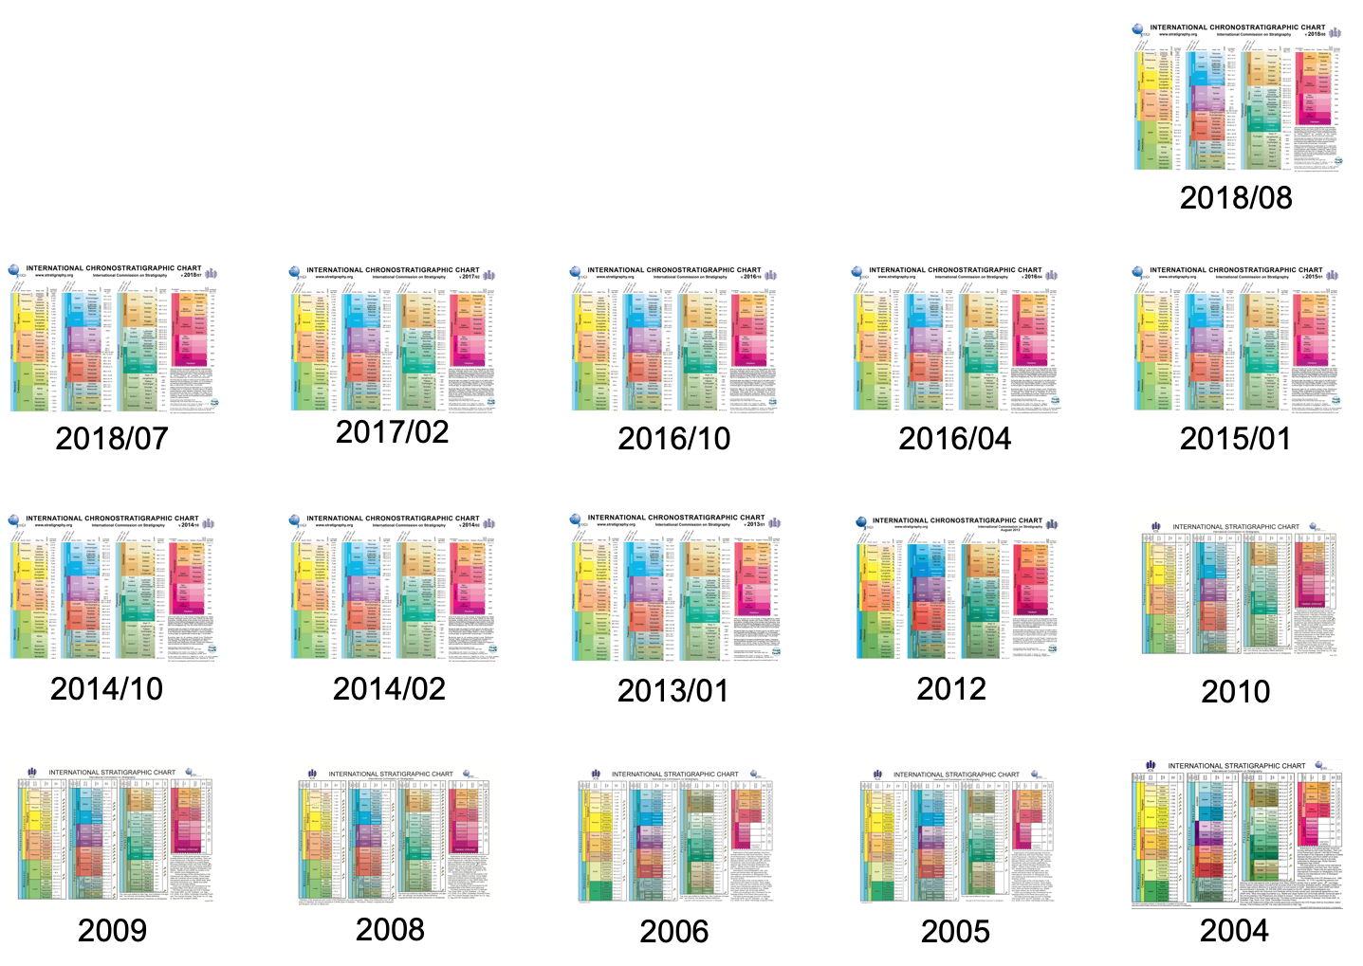
International Commission on Stratigraphy updates the chart continuously based on latest research
Cox and colleagues were trying to release a new vocabulary for each version of the chart
http://resource.geosciml.org
SISSVoc for vocabulary service: the URI of a concept automatically redirects to the information in the latest version of the vocabulary (Cox et al., 2016)
9

Slide 10
Our objective
Represent the version information in a single knowledge graph
It is tedious to create a separate vocabulary for each version of the ISC chart
Different ontologies were used: It is complicated or even impossible to query the updated concepts and attributes or their version history among those vocabularies
But, we will not reinvent the wheel…
Notes:
Our aim is not to reinvent the wheel. Instead, the new structure is based on the ontologies developed by Cox and Richard and it reuses the existing vocabularies, which makes the result fully compatible with the existing work.

Slide 11
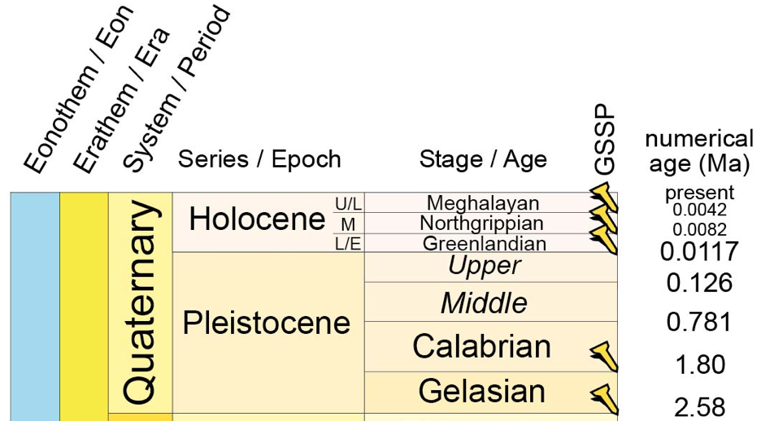
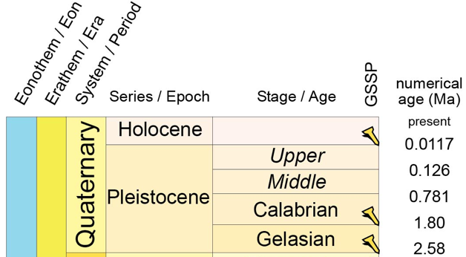
The version control structure
Versioning of concepts, attributes and relationships
2018/07
2017/02
Concept versioning
http://www.stratigraphy.org/ICSchart/ChangeLog2012-2013-2014-2015-2016-2017-2018.txt

Slide 12
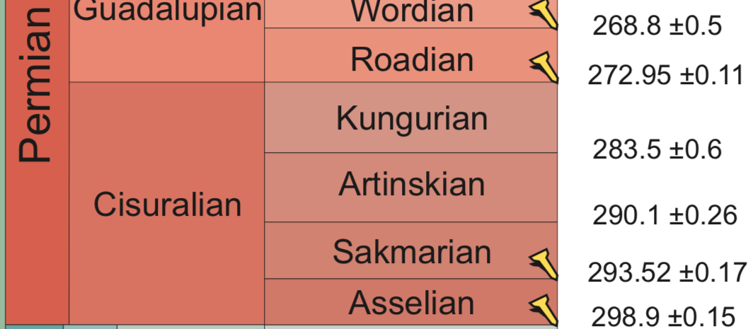
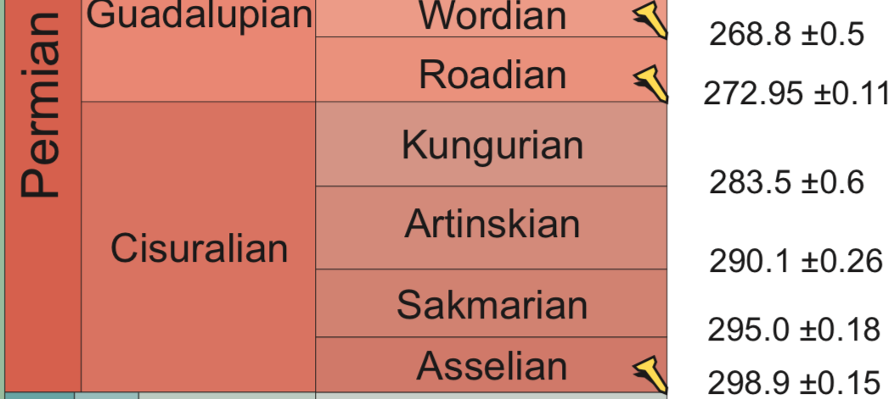
2018/08
2018/07
Attribute versioning

Slide 13
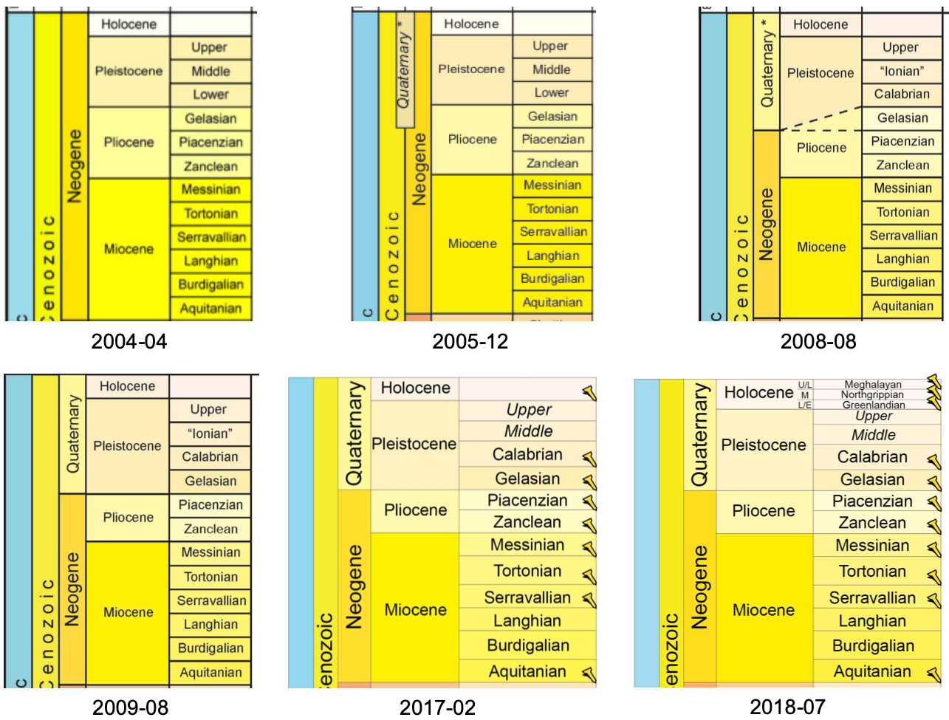
Relationship versioning
See relationship between Quaternary and other concepts

Slide 14
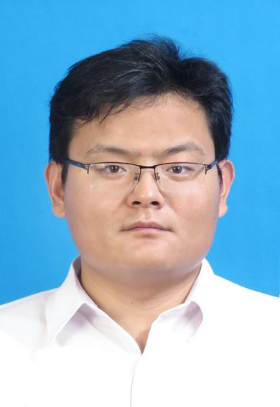

Our design
Core idea: make full use of the vocabulary scheme IDs
Design a structure to specify which concepts, attributes and relationships (changed or unchanged) are in which corresponding ISC vocabulary schemes
Chengbin Wang
Salil Reddy
Chao Ma
Can Cai

Slide 15
Example
Jurassic and its base boundary age in four different vocabulary schemes
Code from
http://resource.geosciml.org

Slide 16
Use vocabulary scheme ID to specify version of Jurassic and its attributes
J
v. 2004-04
J
v. 2010-09
BJ
BJ
v.
2004-04
v.
2010-09
v.
2012-08
v.
2017-02
BJP
BJU
BJT
BJU
J
199.6
0.6
199.6
0.6
BJ
v.
2004-04
v.
2004-04
199.6
BJT
BJU
0.6
J
v.
2012-08
J
v.
2017-02
v.
2010-09
v.
2010-09
201.3
0.2
BJ
BJ
v.
2012-08
v.
2017-02
BJT
BJU
BJT
BJU
J – Jurassic
BJ – BaseJurassic
BJP/T – BaseJurassicPosition/Time
BJU – BaseJurassicUncertainty
201.3
0.2
201.3
0.2

Slide 17
Resulting version specification
At concept level:
At attribute level:

Slide 18
Version specification for the relationships between Jurassic and other concepts

Slide 19
Relationship versioning
How to represent the complicated situation of Quaternary?

Slide 20
Version specification for the relationships between Quaternary and other concepts

Slide 21
Consistency with existing ontologies and vocabularies
We reused the existing ontologies and did not make any changes
All versions of the ISC charts are now represented in a single vocabulary
The URI of each time concept or attribute remains the same as in the existing vocabularies
Show the complete versioning history of concepts, attributes, and relationships

Slide 22
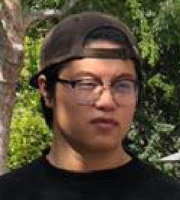
Results are Open Source
The .ttl file of the resulting vocabulary is accessible at:
https://github.com/xgmachina/geotimeversion/
A SPARQL endpoint has been set up
Triple store: http://virtuoso.nkn.uidaho.edu:8890/sparql/
Using the graph name http://deeptimekb.org/iscallnew
More applications will be released
Project website: https://www.deeptimekb.org
Twitter: @dtkb11
Will join us soon:
CUG: Wenjia Li – visiting scholar
NSF: Jiyin Zhang – PhD student
NSF: Three undergraduate interns
Chao Ma
Amruta Kale
Chenhao Li
Can Cai

Slide 23
Example query 1: find the age and uncertainty at the base of a given concept (e.g., Jurassic) in a given version of the ISC chart
prefix dc: <http://purl.org/dc/elements/1.1/> prefix gts: <http://resource.geosciml.org/ontology/timescale/gts#> prefix skos: <http://www.w3.org/2004/02/skos/core#> prefix time: <http://www.w3.org/2006/time#> prefix ts: <http://resource.geosciml.org/vocabulary/timescale/> SELECT ?tconcept ?basetimevalue ?btuncertvalue WHERE { GRAPH <http://deeptimekb.org/iscallnew> { ?tconcept skos:prefLabel "Jurassic"@en ; dc:description [ time:hasBeginning ?baseboundary ; skos:inScheme ts:isc2012-08 ] . ?baseboundary time:inTemporalPosition ?basetime . ?basetime dc:description [ time:numericPosition ?basetimevalue ; skos:inScheme ts:isc2012-08 ] ; gts:positionalUncertainty ?basetimeuncert . ?basetimeuncert dc:description [ time:numericDuration ?btuncertvalue ; skos:inScheme ts:isc2012-08 ] . } }
Result
tconcept | basetimevalue | btuncertvalue
http://resource.geosciml.org/classifier/ics/ischart/Jurassic | 201.3 | 0.2

Slide 24
Example query 2: retrieve the whole version history of age and uncertainty at the base of a concept across all the vocabulary schemes
prefix dc: <http://purl.org/dc/elements/1.1/> prefix gts: <http://resource.geosciml.org/ontology/timescale/gts#> prefix skos: <http://www.w3.org/2004/02/skos/core#> prefix time: <http://www.w3.org/2006/time#> prefix ts: <http://resource.geosciml.org/vocabulary/timescale/> SELECT ?tconcept ?basetimevalue ?btuncertvalue ?schemeid WHERE { GRAPH <http://deeptimekb.org/iscallnew> { ?tconcept skos:prefLabel "Triassic"@en ; dc:description [ time:hasBeginning ?baseboundary ; ] . ?baseboundary time:inTemporalPosition ?basetime . { ?basetime dc:description [ time:numericPosition ?basetimevalue ; skos:inScheme ?schemeid ] . } UNION { ?basetime dc:description [ time:nominalPosition ?basetimevalue ; skos:inScheme ?schemeid ] . } OPTIONAL { ?basetime gts:positionalUncertainty ?basetimeuncert . ?basetimeuncert dc:description [ time:numericDuration ?btuncertvalue ; skos:inScheme ?schemeid ] . } } } ORDER BY DESC (?schemeid)
Result
tconcept | basetimevalue | btuncertvalue | schemeid
http://resource.geosciml.org/classifier/ics/ischart/Triassic | 251.902 | 0.024 | http://resource.geosciml.org/vocabulary/timescale/isc2018-08
http://resource.geosciml.org/classifier/ics/ischart/Triassic | 251.902 | 0.024 | http://resource.geosciml.org/vocabulary/timescale/isc2018-07
http://resource.geosciml.org/classifier/ics/ischart/Triassic | 251.902 | 0.024 | http://resource.geosciml.org/vocabulary/timescale/isc2017-02
http://resource.geosciml.org/classifier/ics/ischart/Triassic | 252.17 | 0.06 | http://resource.geosciml.org/vocabulary/timescale/isc2016-10
http://resource.geosciml.org/classifier/ics/ischart/Triassic | 252.17 | 0.06 | http://resource.geosciml.org/vocabulary/timescale/isc2016-04
http://resource.geosciml.org/classifier/ics/ischart/Triassic | 252.17 | 0.06 | http://resource.geosciml.org/vocabulary/timescale/isc2015-01
http://resource.geosciml.org/classifier/ics/ischart/Triassic | 252.17 | 0.06 | http://resource.geosciml.org/vocabulary/timescale/isc2014-10
http://resource.geosciml.org/classifier/ics/ischart/Triassic | 252.17 | 0.06 | http://resource.geosciml.org/vocabulary/timescale/isc2014-02
http://resource.geosciml.org/classifier/ics/ischart/Triassic | 252.17 | 0.06 | http://resource.geosciml.org/vocabulary/timescale/isc2013-01
http://resource.geosciml.org/classifier/ics/ischart/Triassic | 252.2 | 0.5 | http://resource.geosciml.org/vocabulary/timescale/isc2012-08
http://resource.geosciml.org/classifier/ics/ischart/Triassic | 251 | 0.4 | http://resource.geosciml.org/vocabulary/timescale/isc2010-09
http://resource.geosciml.org/classifier/ics/ischart/Triassic | 251 | 0.4 | http://resource.geosciml.org/vocabulary/timescale/isc2009-08
http://resource.geosciml.org/classifier/ics/ischart/Triassic | 251 | 0.4 | http://resource.geosciml.org/vocabulary/timescale/isc2008-08
http://resource.geosciml.org/classifier/ics/ischart/Triassic | 251 | 0.4 | http://resource.geosciml.org/vocabulary/timescale/isc2006-04
http://resource.geosciml.org/classifier/ics/ischart/Triassic | 251 | 0.4 | http://resource.geosciml.org/vocabulary/timescale/isc2005-12
http://resource.geosciml.org/classifier/ics/ischart/Triassic | 251 | 0.4 | http://resource.geosciml.org/vocabulary/timescale/isc2004-04

Slide 25
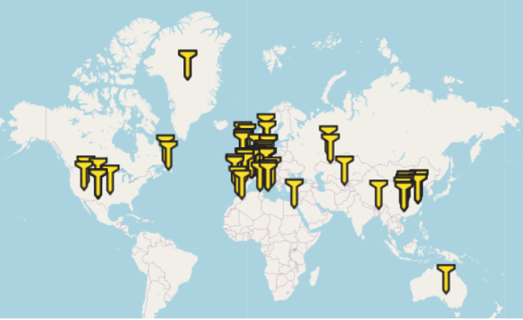
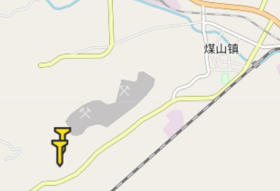
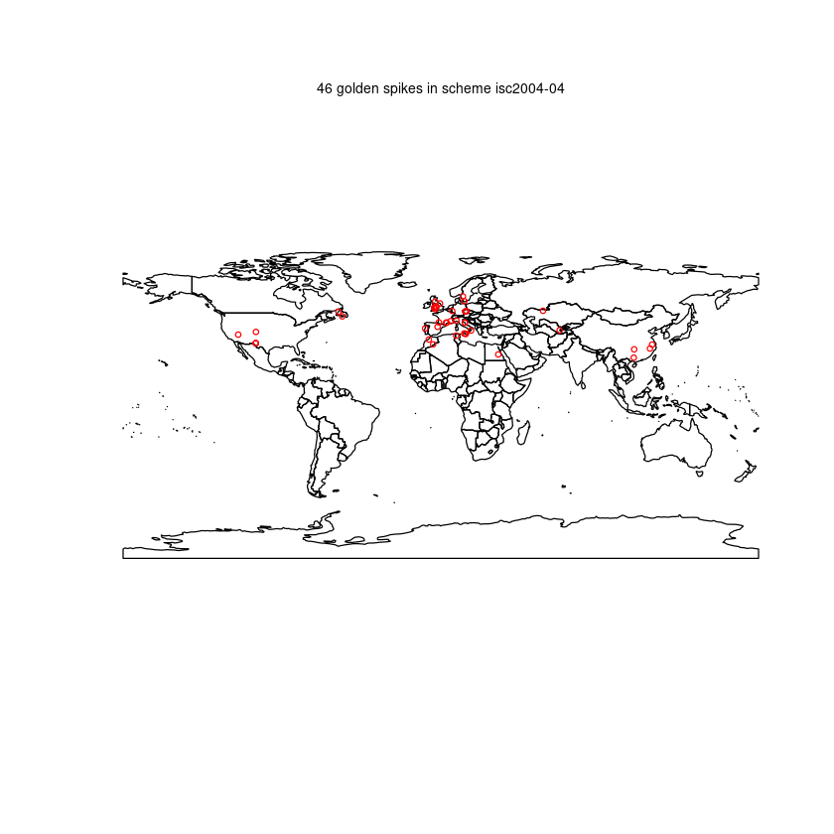















Example query 3: build a golden spike map for each version of the ISC chart
Check source code of the Jupyter notebooks at:
https://jupyterhub.nkn.uidaho.edu/user/max/notebooks/GSSP%20Map%20-%20of%20a%20known%20global%20vocabulary%20scheme.ipynb
https://github.com/xgmachina/DeepTimeKB/blob/master/Notebooks/GSSP%20Map%20-%20a%20map%20for%20each%20global%20vocabulary%20scheme.ipynb

Slide 26
Summary
The ontologies and vocabularies presented in Cox and Richard (2015) and Cox (2019) demonstrate the latest progress on a machine-readable deep time knowledge graph
Yet, it is tedious job to build a separate vocabulary and endpoint for each version of the ISC chart
The different ontology patterns cause challenges for queries across the vocabulary schemes
Our work addresses the limitation of version control in the current deep time knowledge graph
It is an empirical approach and we still need to do more tests on its usability and usefulness in practice
We are now extending the vocabulary to incorporate two new versions of the ISC chart released in 2019 and 2020
Try it at: https://github.com/xgmachina/geotimeversion/

Slide 27




Acknowledgement
Support from National Science Foundation under Grant No. 1835717
Travel support from IUGS Deep-time Digital Earth (DDE) Big Science Program, the Deep Carbon Observatory, the Alfred P. Sloan Foundation, and the Carnegie Institution for Science for communicating the research at several meetings
More Information
Thank You
27
deeptimekb.org

Slide 28
Resources of interest
Cox, S.J.D., Richard, S.M., 2005. A formal model for the geologic time scale and global stratotype section and point, compatible with geospatial information transfer standards. Geosphere 1 (3), 119-137.
Ma, X., Asch, K., Laxton, J.L., Richard, S.M., Asato, C.G., Carranza, E.J.M., van der Meer, F.D., Wu, C., Duclaux, G., Wakita, K., 2011. Data exchange facilitated. Nature Geoscience 4 (12), 814.
Ma, X., Carranza, E.J.M., Wu, C., van der Meer, F.D., Liu, G., 2011. A SKOS-based multilingual thesaurus of geological time scale for interoperability of online geological maps. Computers & Geosciences 37 (10), 1602-1615.
Perrin, M., Mastella, L., Morel, O., Lorenzatti, A., 2011. Geological time formalization: an improved formal model for describing time successions and their correlation. Earth Science Informatics 4 (2), 81-96.
Ma, X., Carranza, E.J.M., Wu, C., van der Meer, F.D., 2012. Ontology-aided annotation, visualization, and generalization of geological time-scale information from online geological map services. Computers & Geosciences 40, 107-119.
Ma, X., Fox, P., 2013. Recent progress on geologic time ontologies and considerations for future works. Earth Science Informatics 6 (1), 31-46.
Cox, S.J.D., Richard, S.M., 2014. A geologic timescale ontology and service. Earth Science Informatics. In Press. DOI: 10.1007/s12145-014-0170-6
Wang, C., Ma, X., Chen, J., 2018. Ontology-driven data integration and visualization for exploring regional geologic time and paleontological information, Computers & Geosciences, 115, 12-19. (Open Access)
GSSP information source: https://engineering.purdue.edu/Stratigraphy/gssp/index.php

